Slide 1
I.A.M.
(Identity Access Management)

Slide 2
Identity Access Management :
Identity Access Management is a tool that controls who has access to your aws (amazon web services ) resources and what they can do with them.
Basically , it is like a security guard that makes sure only the right people with the right permissions can access the things you need.
Its a cybersecurity practices that enables IT administrators to restrict access to organizational resources so that only the people who need access or have access.

Slide 3
Key components of I.A.M.
User
Groups
M.F.A.
(multi factor authentication)

Slide 4
User : Lets take an example , An i.a.m. user is an employee at a company who is given limited access as per the requirement whereas , a root user is the owner of that company with the absolute authority and power who can fire (delete user) at any time.
Group : let a group be created whose name is “admin” then the users in that group can be granted the any permission in one click rather than give them permission one by one.
MFA : MFA is a multi level security system that protects the users data from any threats and unauthorised means.

Slide 5
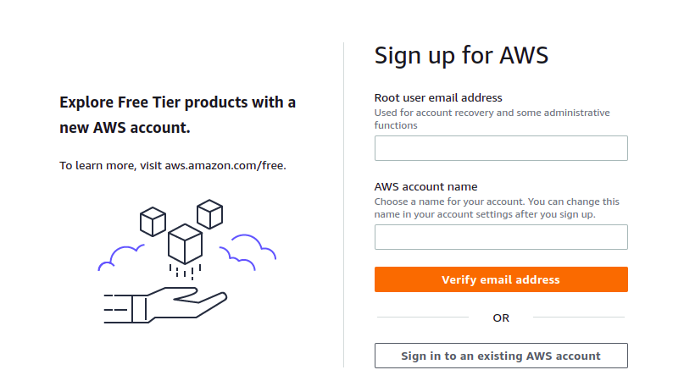
How to create an I.A.M. user
Step 1. Sign in as a root user provide username and password when required

Slide 6
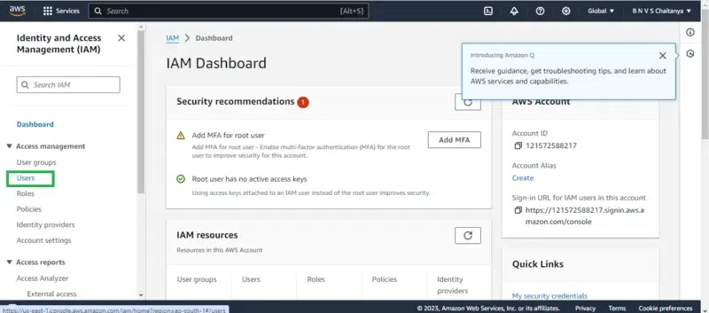
Step 2. Navigate to the the dashboard tab , click on identity and access management drop-down menu on the left side , then click on users option.

Slide 7
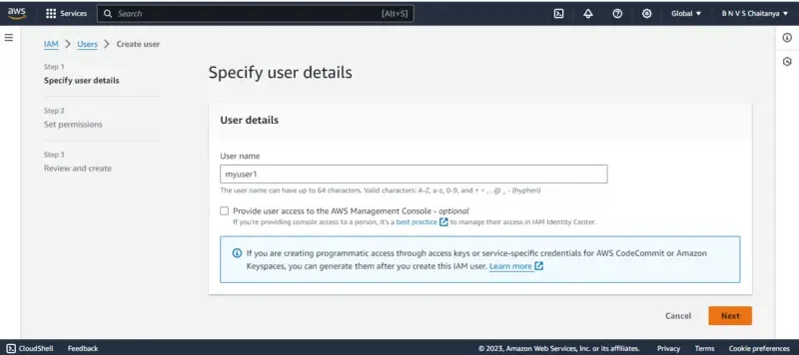
Step 3. Click on add user. Provide username and click on aws management console access. Click on the checkbox next to administrator option (giving the user permission to become an administrator). Click next.

Slide 8
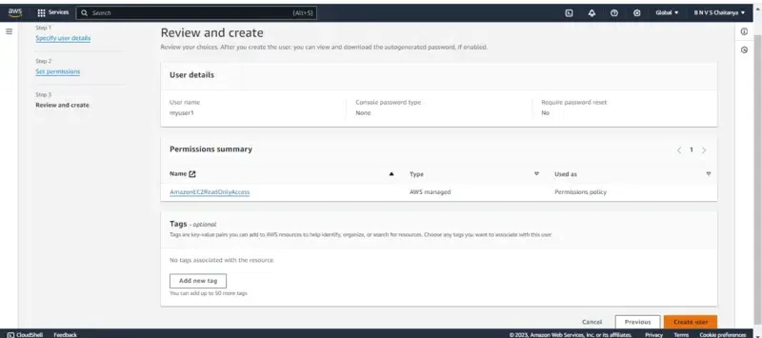
Step 5. Set permissions. Add the user to a group. Click on review and create the user .

Slide 9
How to create Groups :
Step 1. Navigate to the IAM dashboard and select “groups”.
Step 2. Click “create group” and provide a group name.
Step 3. Attach group policies to define group’s permissions.
Step 4. Add users to the group for instant permission granting.

Slide 10
How to setup MFA :
Step 1. Sign-in to your account
Step 2. Select the desired IAM user.
Step 3. Click on security credentials tab . under the multifactor authentication section, choose manage.
Step 4. Choose the type of MFA you want to use.
Step 5. Once the device is configured you will be required to use another verification code generated by your MFA.

